Slide 1
PROJECT MANAGEMENT & ENTREPRENEURSHIP (KHU 702)

Slide 2
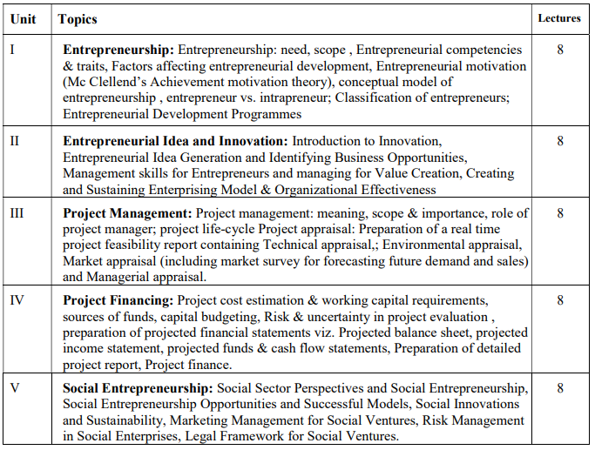
Syllabus

Slide 3
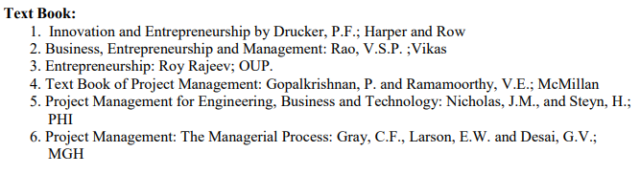
List of Books

Slide 4
Unit-1 Syllabus
Entrepreneurship:
Entrepreneurship: need, scope , Entrepreneurial competencies & traits,
Factors affecting entrepreneurial development,
Entrepreneurial motivation (Mc Clellend’s Achievement motivation theory),
Conceptual model of entrepreneurship ,
Entrepreneur vs. intrapreneur;
Classification of entrepreneurs;
Entrepreneurial Development Programmes

Slide 5
Introduction to Entrepreneurship
Entrepreneurship has become increasingly important for businesses of all sizes around the world.
It opens new opportunities and possibilities for the businesses to create values for themselves and for the society at large.
Despite its popularity, studies suggest that the scope of entrepreneurship remains unknown, and therefore the prospects of entrepreneurial activities remains not fully realised.

Slide 6

Who is an Entrepreneur............

Slide 7
Who is an Entrepreneur............
The term 'Entrepreneur' -French word 'Entreprendre’ (meaning to undertake certain activities)
Entrepreneur:
1) Produces a product from his core idea
2) Sells & market the product
3) Bear overheads like :-
*Pays rent of Land and building
*wages to labor
*interest on capital
*later generate profit

Slide 8
Working Definition Entrepreneur
An entrepreneur is a person who combines various factors of production, processes raw material, converts the raw material into a finished product and creates utility and sells the product in the market to earn profit.
Entrepreneurship essentially refers to the act of starting and operating a business.
In this context, an entrepreneur aims to take risks, identify opportunities, and create value by offering products or services that meet market needs.
An entrepreneur is a person who evaluates the new situation in the environment and directs the making of such adjustments or alternations in the economic or manufacturing systems as he thinks necessary for achieving desired results.

Slide 9
Entrepreneur: a catalyst for economy
In the modern day markets, the term entrepreneur has been closely linked with economic development.
An economic development can emerge due to several reasons, which includes:
(a) the launch of new source of procurement for raw materials or materials
(b) the introduction of a new production mechanism
(c) the introduction of a new quality of product, or a novel product
(d) the opening of new market
(e) the re-organisation of a business.
The people whose functions are to carry out various such activities are called entrepreneurs (Bull & Willard, 1993)

Slide 10
Définition of an Entrepreneur
To date, several definitions have been penned to describe an entrepreneur. And some of them are mentioned herewith:
Entrepreneur is someone who manages all the necessary resources to produce and market a product which responds to the market scarcity (Leibenstein, 1968; Bull & Willard, 1993).
“Entrepreneurs are individuals who recognize opportunities where others see chaos contradiction, and confusion. They are aggressive catalysts for change within the marketplace” Kuratko (2016, p.3)
“Entrepreneur is the person who carries out new combinations, causing discontinuity. The role is completed when the function is completed. The person may be an employee with an existing organisation or may start a new venture. An investor per se only risks capital for a return.” Bull & Willard (1993, p. 186)

Slide 11
Characteristics of an Entrepreneur
The main characteristics of the entrepreneur are due to their sociological and psychological factors. Some of those characteristics are mentioned below:
Entrepreneurs are vision-oriented people
Entrepreneurs have a high need in achievement
Entrepreneurs do not rely on fate or luck, however they try to control their own lives
Entrepreneurs undertake moderate risks, which is why they look for high earning on their investments
Entrepreneurs have the abilities to deal with several ambiguous situations in their ventures. They face these ambiguous situations and circumstances regularly because they do certain jobs and tasks which are entirely new by nature.
Entrepreneurs have the tendency to be productive and efficient with in a given period of time.

Slide 12
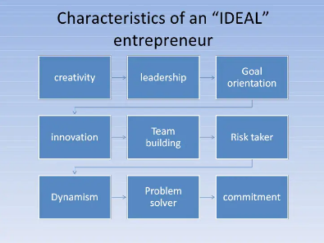

Slide 13
ENTREPRENEURSHIP May defined in various ways, but the four key elements involved in it are:
Innovation.
Risk-taking.
Vision.
Organizing skill.
The capacity and willingness to develop, organize and manage a business venture along with any of its risks in order to make a profit. The most obvious example of entrepreneurship is the starting of new businesses.

Slide 14
Entrepreneurship refers to the process of creating and managing a new business venture to achieve financial success and make a positive impact on society
Creation of TOMS Shoes:
TOMS Shoes was founded in 2006 by Blake Mycoskie after a trip to Argentina, where he witnessed children living without shoes.
Inspired by the concept of "One for One," Mycoskie created TOMS with the mission of providing a pair of shoes to a child in need for every pair of shoes sold.
Managing a New Business Venture:
Mycoskie launched TOMS as a for-profit business venture, aiming to blend entrepreneurship with social impact.
He managed the business operations, including sourcing materials to ensure the sustainability and growth of the company.
Financial Success:
Despite initial challenges and skepticism, TOMS Shoes achieved remarkable financial success, driven by its innovative business model and compelling social mission and responsibility.
Positive Impact on Society:
TOMS Shoes has made a significant positive impact on society through its innovative approach to corporate social responsibility.
By providing shoes to children in need, TOMS has helped improve their health, education, and overall quality of life, while also raising awareness about the importance of footwear in impoverished communities.

Slide 15
“Entrepreneurship is a composite of three basic elements-invention, innovation and adaptation” Johnson
Invention:
In 2007, Brian Chesky and Joe Gebbia, the founders of Airbnb, were struggling to pay rent for their apartment in San Francisco.
Got idea of renting out air mattresses on their floor to attendees of a local conference to earn extra money.
This initial idea was an invention in itself – using spare space in their apartment to accommodate travelers when hotels were fully booked.
It was a creative solution to a common problem: the high demand for accommodation during peak times.
Innovation:
Form the idea Chesky and Gebbia realized the potential to create a platform that would connect travelers with hosts offering unique and affordable accommodations.
They innovated by developing the Airbnb platform, which allowed hosts to list their properties and travelers to find and book accommodations directly.
Airbnb's innovation extended beyond traditional hotel stays to include a wide range of unique and personalized lodging options, such as apartments, houses, treehouses, and even castles.
Adaptation:
As Airbnb grew, the founders faced various challenges, including regulatory issues, safety concerns, and user experience enhancements.
They adapted their business model and strategies to address these challenges by implementing features such as identity verification, host insurance, and customer support services.
Airbnb also expanded its offerings beyond accommodations to include experiences and activities hosted by locals, catering to travelers seeking authentic and immersive experiences.

Slide 16
The art of identifying opportunities, taking calculated risks, and bringing new ideas to life by creating new businesses or organizations.
Let's illustrate this definition with the case study of Elon Musk and his ventures, including Tesla, SpaceX, and Neuralink:
Identifying Opportunities:
Elon Musk identified opportunities in electric vehicles, renewable energy, space exploration, and neural interface technology.
He recognized potential for disruption and innovation in these emerging industries.
Taking Calculated Risks:
Musk invested personal wealth and resources into ventures like Tesla, SpaceX, and Neuralink.
He took bold risks, such as developing reusable rocket technology and investing in electric vehicles when they were not mainstream.
Bringing New Ideas to Life:
Musk's ventures represent innovative solutions to complex problems.
Tesla produces electric vehicles and energy products, SpaceX develops reusable rockets and aims for Mars colonization, and Neuralink works on brain-computer interface technology.
Musk's ability to translate visionary ideas into tangible products showcases the transformative power of entrepreneurship.

Slide 17
Entrepreneurship entails bearing the risk of buying at a certain price and selling at uncertain prices.” Ricardo Cantillon
John's Mobile App Startup Case Study:
Buying at a Certain Price:
John, a tech enthusiast, develops a new mobile app aimed at improving productivity for remote workers. He invests time, resources, and funds into developing the app, including software development, user interface design, and testing.
John's investment represents the "buying" phase of entrepreneurship, where he incurs costs to bring his product to market. He has a clear understanding of the expenses associated with developing and launching his app.
Selling at Uncertain Prices:
Once John completes development, he faces the challenge of selling his mobile app at uncertain prices in the market. The demand for productivity apps may fluctuate based on user preferences, competitor offerings, and market trends.
John sets an initial price for his app based on competitor analysis, perceived value, and pricing strategies. However, he cannot predict with certainty how users will respond to his pricing and whether they will be willing to pay for his app.
Bearing the Risk:
As an entrepreneur, John bears the risk of buying resources at certain prices and selling his app at uncertain prices in the market.
If John fails to attract users or generate sufficient revenue from app sales, he risks financial losses and the viability of his startup.
John must navigate the uncertainties of the app market, adjust his pricing strategies, and effectively market his app to mitigate risks and maximize user adoption and profitability.

Slide 18
Other Definitions
“Entrepreneurship is any kind of innovative function that could have a bearing on the welfare of an entrepreneur.” Joseph A. Schumpeter
A.H. Cole said that Entrepreneurship is the purposeful activity of an individual or a group of associated individuals, undertaken to initiate, maintain or aggrandize profit by production or distribution of economic goods and services

Slide 19
Milkymist: Entrepreneurship story of a young boy. Established 2000 Crore dairy product Venture
In 1992 in 17 Yr. old school boy realized the following concerns in his father business.
Very low profit in the milk selling business of his father(30 Paise to 1 Rs. Per Litre)
Margin was barely 3-5% even negative sometimes.
Shorter Shelf life of milk, Had to sell the milk within 10 Hours to make profit or else lead to loss.
Logistics was difficult lead to problem in business expansion.

Slide 20
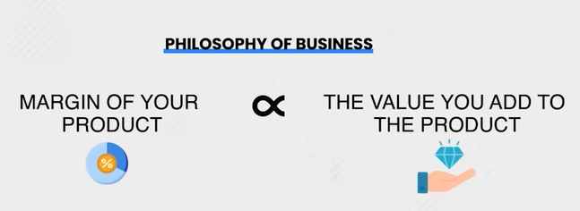
Mechanism
MilkyMist Case Study
He started the strategy of value addition by commoditization of milk following the principle.

Slide 21
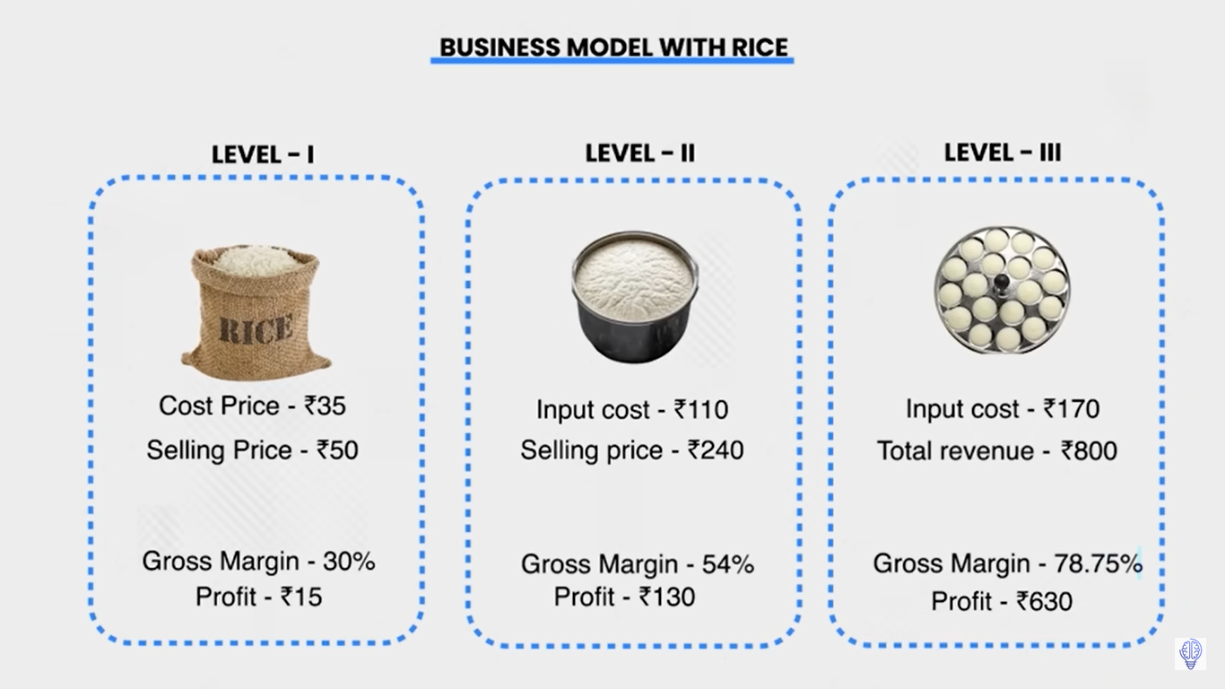
Example of value addition
MilkyMist Case Study
Buy and Sell only Model
( RICE+URAD+OTHER) MAKE IDLI 3KG BATTER AND THEN SELL@80 Rs. KG)
3KG BATTER CAN MAKE 60 IDLIS AND THEN 20 Rs./ KG OTHER COST AND SELL@40 PER PLATE OF 3 IDLIS)

Slide 22
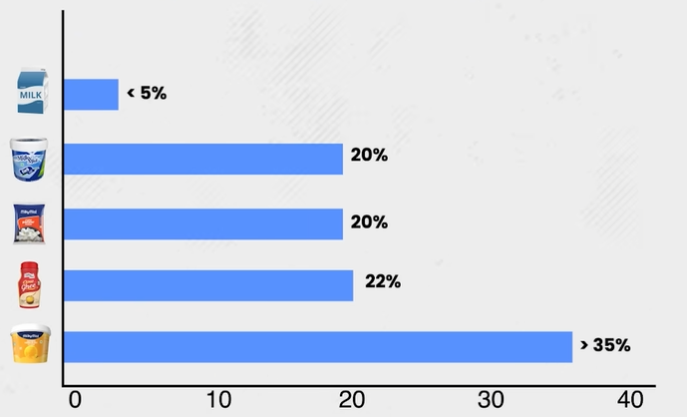
How Milky Mist apply the philosophy of Value addition
MilkyMist Case Study
Procured Milk and Turned into other dairy products and seen the effect of value addition

Slide 23
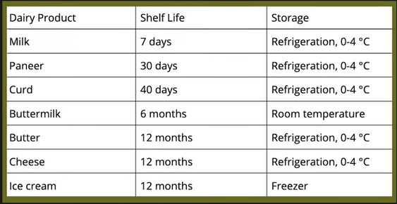
What benefits Owner( Satish Got)
MilkyMist Case Study
Competitors reduced by large extent
Margins increased
Shelf life of product increased

Slide 24
Learning from the case study till now
MilkyMist Case Study
If you are in a business of just purchasing and selling you may kill your own margins with price wars.
But if you use value addition you can escape the price wars of market and actually make a profit.

Slide 25
Challenges
MilkyMist Case Study
Southern part of India 1990 the consumption of Cheese was very less and usually used in big hotels.
Majorly due to less adaption of refrigeration by common people(20%).
In Late 1991 Globalization effect impacted the economic growth and market opened up and many people got good jobs.
Every individual and people become aware of nutrition and health and realized cheese as important source of protein especially vegetarian. Suddenly cheese started selling to great extent that lead to further challenges.
Milk source was fragmented leading to scattered supply (No internet , very less highways, and transport No contract with farmers.)
Less loyal farmers, so lead to less supply of milk.
Inconsistent quality of Milk.

Slide 26
How he solved challenges
MilkyMist Case Study
Scattered milk supply: He identified an area in south called erode milk belt, due to Kaveri water availability, most of the farmers nourish their dairy animals in that area only and made erode as largest milk producing belt. Lead to easy procurement of milk.
Challenge of farmer loyalty was solved by identifying the challenging problems of farmers life and helped in solving them( Lack of loans, Animal care and providing better cattle seed, Education of latest technology, Weekly payments of due’s to given them better cash flow and is digital now a days.)
These effort of Milky Mist lead to : High quality of Milk Consistent Supply of Milk No worry of competitors stealing their business.
Lesson : Helping the partners lead to mutual benefits and long term growth.

Slide 27
With Sufficient supply How Milky-Mist managed to sell their products compared to its competitions
MilkyMist Case Study
Initially started with 5-Star hotels with strict quality regulation of cheese with perfect consistency compared to local vendors.
But 5-start market was limited so they moved to Kirana stores.
Expanding to Kirana stores further posed challenges. 1. Kirana stores don’t have chillers to store the cheese.
2. Transportation from factory to stores was a big problem as shelf life paneer with refrigeration is less than 48 hrs.
So Company had only 48 hours to ship distribute and sell cheese and get spoiled immediately if customer don’t have refrigerator.

Slide 28
Solution to Problem of Logistics and refrigeration to increase the shelf life
MilkyMist Case Study
High cost solutions
Decided to distribute 20K chillers to their retailers.
Installed chilling technologies in the transportation trucks.
This made milky-mist one of first company to make cold storage supply chain without outsourcing the same to ensure quality.
Further Problem>
Due to trucks beings of 3rd party, drivers were shutting down the refrigeration in between leading to less shelf life.
Delay in scheduled delivery.
So milky mist decided to purchase the trucks of their own to control journey time and quality of product.

Slide 29
Problems and opportunity from the solution
MilkyMist Case Study
After owning trucks, the return journey of all the trucks was wasted, leading to increased transport cost.
Milkymist applied strategy(for say if truck transport milk to Kashmir , on return they might carry apple from Kashmir to cover the loss).
This how milkymist found gap in market and leveraged to earn further profit.
And today milkymist have more than 250 cargo trucks with GPS Navigation to keep track of data and location.

Slide 30
Lesson Learnt
MilkyMist Case Study
If you use value addition and branding you can beat the price wars and competitors.
While good companies focus on find maximum profit from their partners, Great companies collaborate with their partners to help them deliver maximum value, as a result end up increasing their profit margins.
Even though outsourcing gives the cash flow, it takes away your control over quality. It can lead to higher cost initially but it will pay you dividend beyond your imagination.

Slide 31
ENTERPRISE :
The final result, that is, the business which is established after undertaking the process of entrepreneurship is called an enterprise.

Slide 32
Types of Participants
DOERS : Achievers Individuals who actively pursue their entrepreneurial ventures and are committed to achieving their goals. They take action, make decisions, and work towards realizing their dreams in the entrepreneurial realm.
DREAMERS : Doing something but not their dream project. They might be working on projects that align with their interests or skills but may not necessarily be pursuing their passion projects.
DWADLERS : Undecided These individuals are characterized by their indecision and lack of clear direction in entrepreneurship. They may have ideas or aspirations but struggle to take decisive action or commit to a particular path.
DUDS : This category includes individuals who have abandoned or given up on their entrepreneurial aspirations. They may have initially pursued entrepreneurial endeavors but ultimately decided to abandon their ideas or projects for various reasons.

Slide 33
Byju(DOER)
Byju Raveendran identified a gap in traditional education and aimed to revolutionize learning through technology.
He founded Byju's, an e-learning platform, in 2011.
Byju's offers interactive learning materials and personalized tutoring for competitive exams and school curriculums.
Byju demonstrated exceptional initiative in content development, effective technology utilization, and nationwide expansion.
Byju's is among India's most successful edtech startups, valued at billions of dollars.
Byju's has positively impacted millions of students across the country.
Byju Raveendran embodies the spirit of a "DOER" in Indian entrepreneurship by transforming his vision into a highly successful venture.

Slide 34
DREAMSER(SNAPDEAL)
Kunal Bahl, co-founder, and CEO of Snapdeal, began the venture in 2010 with Rohit Bansal.
Bahl was motivated by the internet's potential to revolutionize retail in India, aspiring to democratize access to products and services nationwide.
His vision aimed to cater to consumers in smaller towns and cities where retail options were limited.
Despite facing stiff competition from Flipkart and Amazon India, Bahl remained committed to making online shopping accessible and affordable for millions of Indians.
Bahl's resilience, adaptability, and unwavering pursuit of his entrepreneurial dreams characterized him as a "dreamer" in Indian entrepreneurship.
Through persistence and strategic adjustments, Bahl successfully transformed Snapdeal into one of India's leading e-commerce platforms.

Slide 35
DWADDLER(VINDO DHAM)
Vinod Dham, known as the "Father of the Pentium chip," initially struggled to find his intrest in the semiconductor industry.
After moving to the United States from India, Dham worked at NCR Corporation and later joined Intel in the 1980s.
Despite his technical expertise, Dham faced challenges in identifying the right entrepreneurial opportunity. He worked on various projects at Intel but hadn't found a breakthrough venture aligned with his aspirations.
Dham experienced uncertainty and indecision during the early years of his entrepreneurial journey. His perseverance eventually led to his involvement in the development of the Pentium microprocessor at Intel.
The Pentium chip revolutionized computing technology and solidified Dham's reputation as a pioneer in the semiconductor industry.
his involvement with the Pentium project, Vinod Dham could be considered a "dwaddler" in the sense that he faced uncertainty and indecision in his entrepreneurial journey.

Slide 36
DUDS(ABONDONERS)
Co-founder and CEO of Housing.com: Rahul Yadav was the co-founder and CEO of Housing.com, a prominent real estate platform in India.
Housing.com initially achieved significant traction and investment due to its innovative approach to the online real estate market.
Yadav's leadership style was marked by outspokenness and confrontational behavior towards investors, board members, and the media.
The board of directors eventually removed Yadav from his position as CEO due to his inability to effectively lead the company.
Yadav's leadership failures and controversies resulted in the abandonment of his entrepreneurial aspirations.
His story serves as a cautionary tale about the dangers of unchecked ego and leadership dysfunction in the startup ecosystem.
Yadav's downfall highlights the importance of effective leadership, collaboration, and ethical conduct in sustaining entrepreneurial ventures.
Yadav's trajectory underscores the need for entrepreneurs to prioritize professionalism, collaboration, and ethical behavior in their endeavors.

Slide 37
Objective of Entrepreneurship
Provides doors to world of opportunities for personal growth
Getting Basic concepts of Entrepreneurship and business knowledge
Develop entrepreneurship mindset
Fosters creativity and Innovation
Increases chances of success
Nation service as you become able to create job opportunities for others as well.

Slide 38
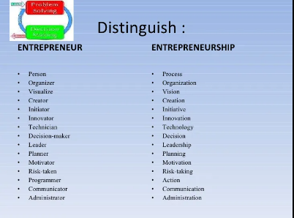

Slide 39
Entrepreneurship Process
Find an Idea
Make Plans
Arrange the resources required
Start your business
Learn and change
Grow
Make People happy

Slide 40
Need of Entrepreneurship
Creating Jobs
(e.g. Flipcart, Amazon created jobs for logistics, customer service, technology, and supply chain management)
Innovation
(e.g Through its innovative use of technology and engaging content, BYJU'S has transformed the way students learn)
Economic growth
(e.g. Paytm, founded by Vijay Shekhar Sharma in 2010, is a leading digital payments platform in India, played a pivotal role in driving the country's digital economy forward)
Problem Solving
(e.g. Swiggy, founded by Sriharsha Majety, Nandan Reddy, and Rahul Jaimini in 2014, is a food delivery platform that addresses the problem of food delivery in urban areas.
Making life easier Ola, founded by Bhavish Aggarwal and Ankit Bhati in 2010, is a ride-hailing platform that has made transportation more accessible and convenient for millions of people in India

Slide 41
Functions of Entrepreneurship
Opportunity Recognition: Identifying needs, trends, gaps
Innovation: Creativity, new ideas, solutions
Resource Acquisition: Funding, talent, technology, infrastructure
Risk Management: Assessment, mitigation, uncertainty
Business Planning and Strategy: Objectives, target markets, competition analysis
Marketing and Sales: Customer needs, positioning, messaging
Financial Management: Budgeting, forecasting, cost control
Networking and Relationship Building: Connections, collaborations, stakeholders
Adaptability and Flexibility: Agility, change, responsiveness
Leadership and Team Building: Motivation, empowerment, collaboration

Slide 42
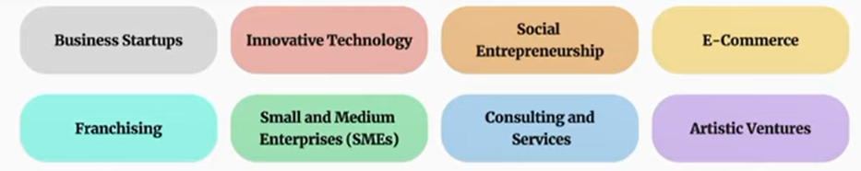
SCOPE of Entrepreneurship
Business Startups | Creating new company e.g. Flipkart, founded as a small online bookstore and grew into one of India's largest e-commerce platforms.
Innovative Technology | Refers to the development and application of novel solutions e.g. swiggy
Social Entrepreneurship | Business principles to address social, cultural, or environmental challenges, Akshaya Patra Foundation, which provides nutritious meals to school children
E-Commrerce | buying and selling of goods and services over the internet. E.g. Amazon India, an online marketplace that offers a wide range of products and services to customers
Frachising | Franchising is a business model where an entrepreneur (franchisee) purchases the rights to use a company's business model in exchange for a fee or royalty. E.g. McDonald's, which operates on a franchise model
SME and Medium Enterprises | Example: Zomato, a restaurant discovery and food delivery platform, started as a small-scale venture and grew into a successful SME
Consulting and services | Consulting and services businesses offer expertise, advice, and solutions to individuals and organizations. E.g. Deloitte India, a professional services firm offering consulting, audit, tax, and advisory services to clients in India and worldwide.
Artistic Ventures | involve creative endeavors such as art, music, literature, film. E.g. Vishal-Shekhar, a music composing duo in Bollywood, who have created numerous hit songs

Slide 43
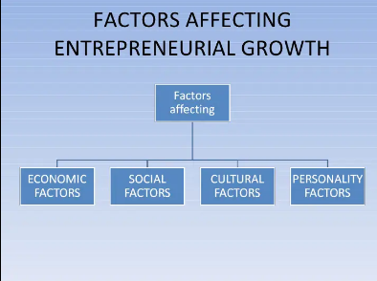

Slide 44
Economic Factors
Market Demand:
During periods of economic growth, consumer spending tends to increase, creating opportunities for entrepreneurs to introduce new products or services.
Conversely, during economic downturns, consumer confidence and purchasing power may decline, affecting demand and potentially constraining entrepreneurship growth.
Access to Funding:
Economic stability and investor confidence play a crucial role in determining the availability of funding for entrepreneurs.
Access to capital markets, venture capital, and bank loans depends on prevailing economic conditions, interest rates, and investor risk appetite.
Government policies and reguations
Government policies, including taxation, trade regulations, intellectual property laws, and business licensing requirements, can either support or inhibit entrepreneurship development
Global Economic Trends:
Entrepreneurship growth is influenced by broader global economic trends, including trade policies, currency exchange rates, and international market dynamics.
Entrepreneurs need to adapt their strategies to navigate changes in global economic conditions and capitalize on emerging opportunities in international markets.

Slide 45
Social Factors
Attitudes Towards Entrepreneurship:
Social attitudes towards entrepreneurship can vary widely across cultures and societies.
Cultures that celebrate entrepreneurship, innovation, and risk-taking tend to foster a supportive environment for aspiring entrepreneurs, encouraging them to pursue their business ideas.
Social Networks and Support Systems:
Strong social networks and support systems, including family, friends, mentors, and professional associations, provide aspiring entrepreneurs with guidance, encouragement, and resources.
Access to supportive networks can boost confidence, provide valuable advice, and facilitate access to funding and market opportunities.

Slide 46
Cultural Factors
Cultural Norms and Values:
Cultural norms and values shape perceptions of entrepreneurship, risk-taking, and success within a society.
Cultures that value individual achievement, innovation, and entrepreneurial endeavors tend to foster a conducive environment for entrepreneurship growth.
Perceptions of Failure:
Cultural attitudes towards failure can significantly impact entrepreneurship. Cultures that stigmatize failure may discourage individuals from taking entrepreneurial risks and pursuing innovative ventures.
In contrast, cultures that view failure as a valuable learning experience and a natural part of the entrepreneurial journey are more likely to support entrepreneurial experimentation and resilience.

Slide 47
Personality Factors
Entrepreneurial Mindset:
Personal characteristics such as ambition, resilience, creativity, and adaptability play a crucial role in entrepreneurship.
Entrepreneurs with a strong entrepreneurial mindset are better equipped to navigate challenges, seize opportunities, and sustain growth in their ventures.
Risk Appetite:
Personal risk tolerance varies among individuals and influences their willingness to undertake entrepreneurial ventures.
Entrepreneurs with a high tolerance for risk are more inclined to pursue innovative ideas, invest resources, and withstand the uncertainties inherent in entrepreneurship.
Motivation and Passion:
Personal motivation and passion drive entrepreneurial endeavors. Entrepreneurs who are passionate about their ideas and committed to their vision are more likely to overcome obstacles, persevere through setbacks, and achieve long-term success.

Slide 48
Other factors includes
Technological factors : (Advances in technology, including digitalization, automation, artificial intelligence, and the Internet of Things (IoT), have transformed the entrepreneurial landscape., access to ICT)
Political Factors:
(Stable political environments promote investor confidence, encourage business growth, and attract foreign investment)
Legal Factors:
(Clear and transparent legal frameworks, including property rights protection, contract enforcement mechanisms, and dispute resolution mechanisms, are essential for fostering entrepreneurship.)

Slide 49
Traits of an Entrepreneur
Some of the common traits of entrepreneurs are :
Risk takers:
Flexible
Knowledgeable
Independent
Energetic
Creative
Dynamic leader
Responsive to suggestions or criticisms
Resourceful
Initiators
Persistent
Passion

Slide 50
Types of Entrepreneurship
There are generally four entrepreneurial types:
Achievement entrepreneur
Salesman entrepreneur
Technology entrepreneur
Manager
Source: Adapted from Carsrud & Brannback, 2007)

Slide 51
Types of Entrepreneurship
Achievement entrepreneur
Primarily associated with the desire to achieve.
These types of individuals are usually having an enormous amount of energy and capabilities to take charge.
They take initiatives and do not wait for things to happen.
They often possess the leadership qualities and have a great sense of commitment and responsibility in their ventures.
These types of individuals are good in several business related aspects and they try to accomplish their objectives, whilst heading their missions.
e.g. Mukesh Ambani (Reliance Industries Limited),
N. R. Narayana Murthy (Infosys),
Azim Premji (Wipro Limited),
Ratan Tata (Tata Group)

Slide 52
Types of Entrepreneurship
Salesman entrepreneur:
These individuals possess skills to interact with people and have very good soft side of the management aspects.
These people are typified for having the feelings of the consumers’ needs and wants.
They usually use the soft sales approach whilst pursuing the growth of their ventures.
They have enormous talent for connecting with people and spend most of their time in marketing their products/services and permit other people to manage their businesses.
These individuals therefore devote their time to understand who and how are the consumers in the market.
They develop a proper vision for marketing and sales practices to reach wider consumer groups.
Vijay Sales( Nanu Gupta)

Slide 53
Types of Entrepreneurship
Technology entrepreneur:
Individuals belong to this category, are generally idea developers.
These individuals often possess great ideas
They have the capabilities to develop innovative processes and invent novel products or services.
As these individuals possess qualities to create several ideas they have a good analytical intelligence and take calculated risks in their ventures.
Although these individuals possess good analytical intelligence to make way through several situations, however, at times their missions can become a bit idealistic.
e.g. Paytm, Ola, Byjus

Slide 54
Types of Entrepreneurship
Manager:
These types of individuals possess the qualities of taking charge of the missions.
Individuals belonging to this type of entrepreneurship are very competitive by nature but not as co-operative as one would expect in a team work.
They are usually found to take positions of high authority, such as external investors or sometimes act as board of directors.
They prefer to work in larger organisations than small entrepreneurial businesses.
They seek comfort in making effective marketing strategies, but not necessary selling products or services.
Their ways to sell are different, they employ logic and carefully thought persuasions, as mechanisms to sell their ideas.
They have rich experiences, strong management skills and possess strength in managing existing businesses

Slide 55
Entrepreneurship opportunities
Entrepreneurship offers several opportunities and some of those opportunities are:
(a) expansion of entrepreneurial activities through the advent of the internet and the
explosion of e-commerce on a global scale.
(b) Integration in social and political fabrics in several emerging economies.
(c) increasing economic situations in middle income house-holds in several economies.
(d) increase in cross-border engagements and market entry mechanisms such as strategic
alliances, subsidiaries, joint ventures etc.
(e) evolving trends in channel structures among the developed world.
(f) increased engagements in global markets concerning social responsibility and ethics (Ramachandran & Gokila, 2012).

Slide 56
Entrepreneurship avenues
Contemporary markets offers several avenues for entrepreneurial activities:
Firstly, entrepreneurs can seek information to understand the balance of trade relationships between the exports in potential markets and the merchandising imports.
Secondly, entrepreneurs can conduct extensive research to understand the political aspects of the global economy to seek other outlines for strategic and operational aspects concerning barriers to enter a market.
Thirdly, entrepreneurs can understand the developments of any domestic market of a country and comprehend how these nations protect their industry by establishing tariffs, quotas, boycotts, non-tariff, monetary and market barriers (Ramachandran & Gokila, 2012).

Slide 57
Entrepreneurship challenges
Although entrepreneurship activities are beneficial, however they come with certain challenges. Some of those challenges are mentioned herewith:
Knowledge gap between the developed, emerging, frontier and under developed markets for conducting business
Difference in accounting systems in several countries
Variable rates of return
Non-convertibility of the currencies
Communication gaps
Language barriers
Source: Adapted from Ramachandran & Gokila (2012).

Slide 58
Entrepreneurship challenges
In addition, to the previously mentioned challenges, there are also some other challenges commonly found in entrepreneurship
Political unrest and legal concerns
Cultural differences
Discrepancies in the use of technology
Complexity in the markets
Supply chain concerns
Lack of specific infrastructure in some countries or regions
Financial markets and their volatility
Source: Adapted from Ramachandran & Gokila (2012).

Slide 59
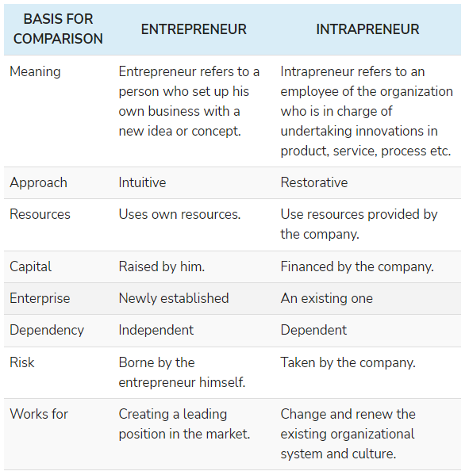

Slide 60
Mc Clellend’s Achievement motivation theory
A theory that states achievement, power, and affiliation are three important needs that help explain motivation.
need for achievement (nAch) The drive to excel, to achieve in relationship to a set of standards, and to strive to succeed.
need for power (nPow) The need to make others behave in a way in which they would not have behaved otherwise.
need for affiliation (nAff) The desire for friendly and close interpersonal relationships

Slide 61
Achievements:
Finding solutions
Acquire complex skills
Setting challenging goals and achieve
Regular Feedback
Rewards and recognition
Praise
Problem solver

Slide 62
Affiliation
Favour for the team work
Maintain Interpersonal relation
Reduce high risk and uncertainty
Value relations

Slide 63
Power
Desire to control and influence others
Like to win arguments
Try to beat their competitors
Status/ Prestige
Control others
Dominating

